Slide 1
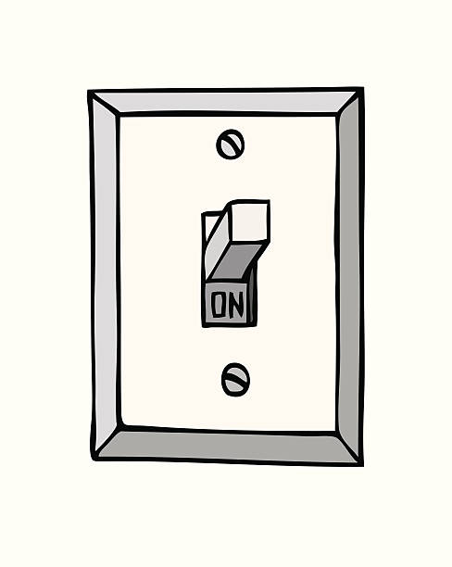

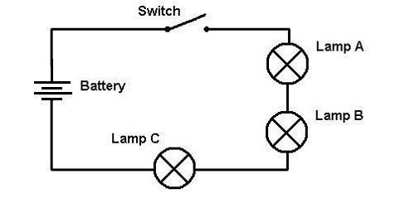
A Light Switch
Input Objects
Processes & Logic
Output Objects
What happens when you flip the light switch?
What different things could happen?

Slide 2
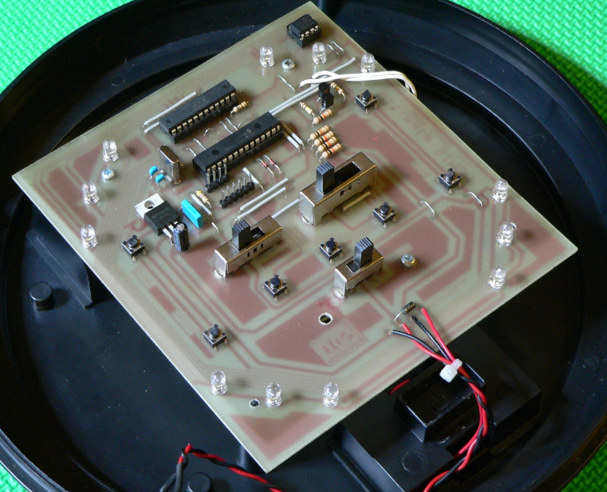
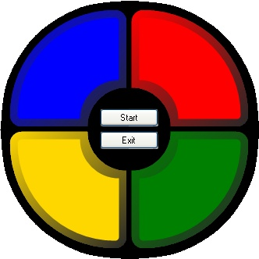
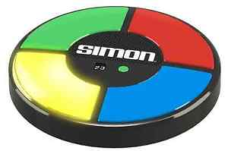
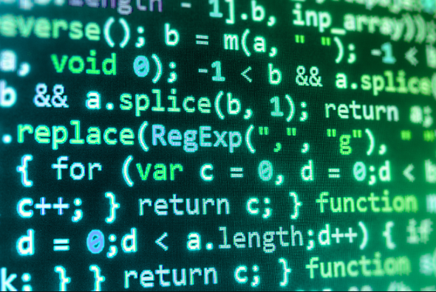
The Simon Game
Input Objects
Processes & Logic
Output Objects
Hardware
Software
What happens when you press the green button?
What different things could happen?

Slide 3
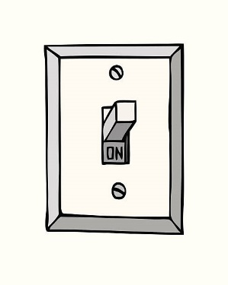
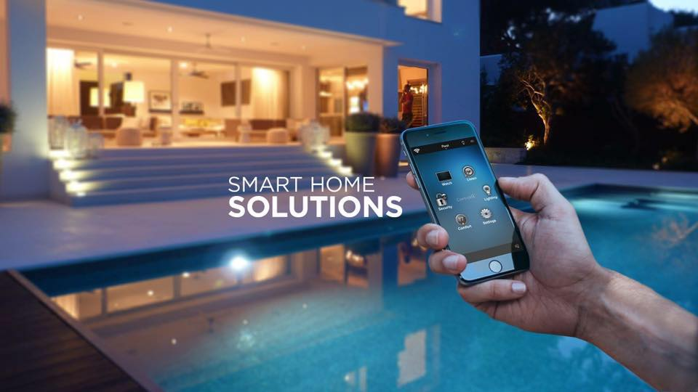
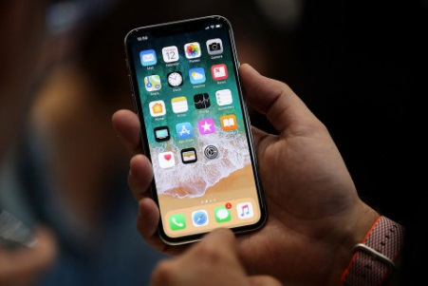
Light Switch – The Future Is Now
Input Objects
Eg. BELL Smart Home
Output Objects
Even basic household wiring will be connected to a controller / computer

Slide 4
Question#6 - Research
Keyword “Emulate”
To duplicate the function of programs designed for one computer so that they can run on another type of computer.
Examples:
Xbox Emulators can run Xbox games on home PCs
Android Emulators can run Android apps on an iPhone
Google Options:
“Simon Game Emulations”

